Slide 1
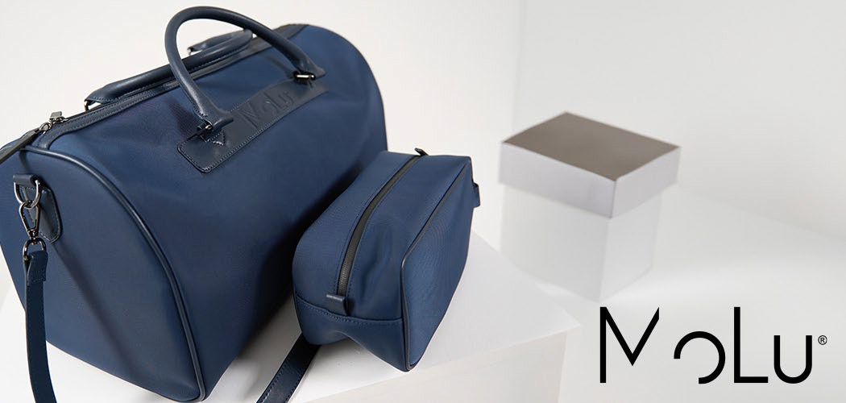
WATER- REPELLENT
2 YEARS WARRANTY
HIGH QUALITY MATERIALS
3931
MoLu Weekender Monaco
A stylish and practical weekender made from high-quality, water- resistant nylon (PU-coated). This versatile travel companion is perfect for short trips and weekend getaways. Equipped with a sturdy zipper, it ensures the security of your personal belongings.The weekender features an adjustable strap and two comfortable handles, providing maximum carrying comfort. The subtle Molu branding gives the bag an exclusive touch and highlights its high-quality craftsmanship.Your personal logo is placed on one side of the bag, offering a premium advertising space that is sure to attract attention. This weekender combines functionality and elegance, making it the ideal companion for style-conscious travelers.
46 × 23 × 24 cm S2
20 × 10
2 YEARS WARRANTY
HIGH QUALITY MATERIALS
3930
MoLu Cosmetic bag Sanremo
Our high-quality cosmetic bag made of nylon (PU-coated) offers the perfect combination of style and functionality. This elegant bag provides ample space for all your cosmetics and accessories and is equipped with a sturdy zipper for added security.Two practical loops allow you to hang the bag conveniently – ideal for both home and travel. The subtle Molu branding gives the cosmetic bag an exclusive touch without being obtrusive.Your personal logo is prominently printed on the front of the bag, providing you with a premium advertising space. This cosmetic
bag is not only a practical companion but also a stylish accessory that presents your brand in an elegant light.
26 × 10 × 13 cm S1
14 × 5

